Slide 1
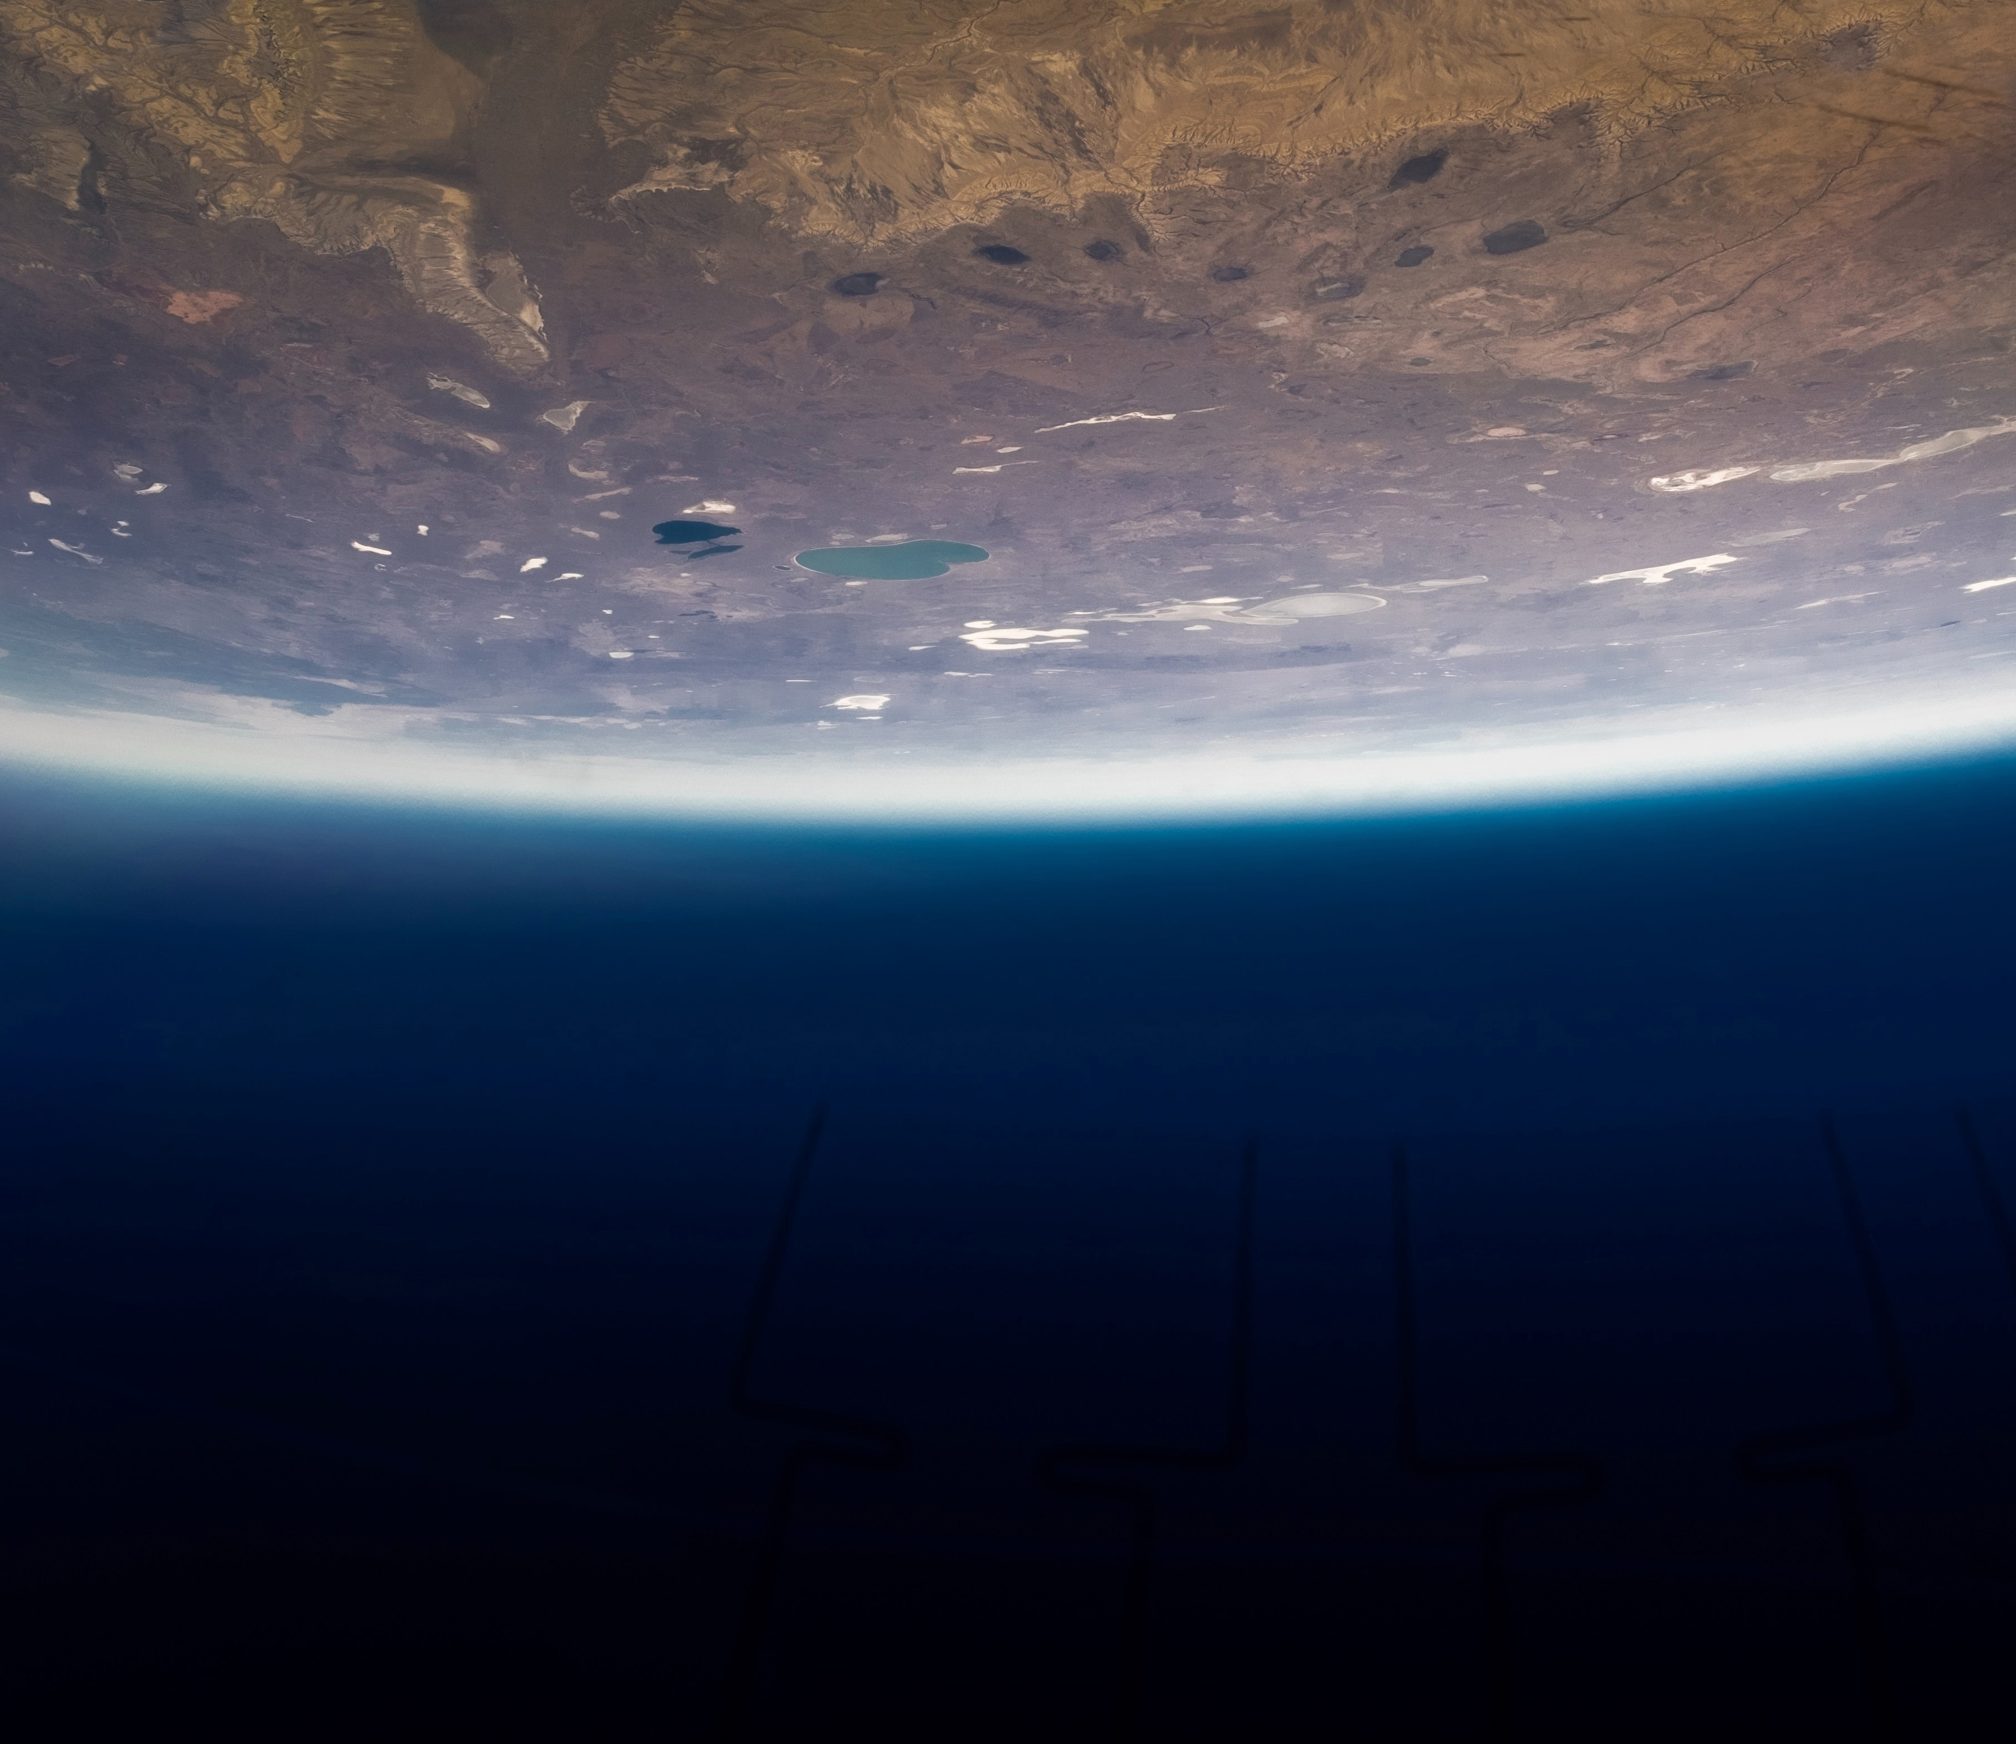

Journey into space

Slide 2
01
Description

Slide 3
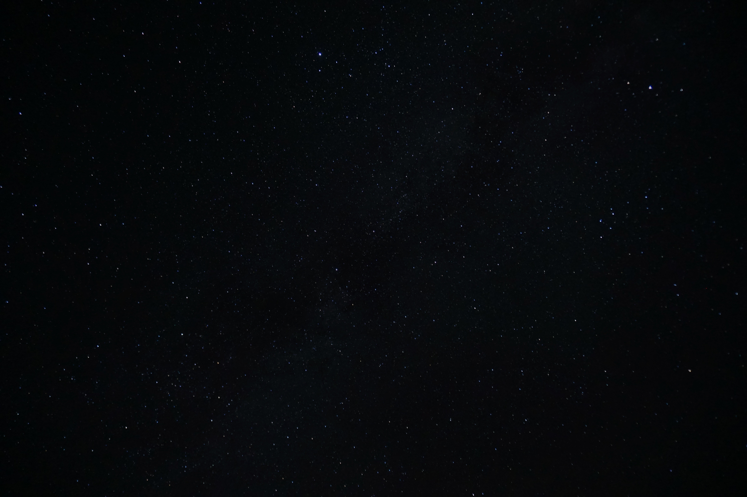
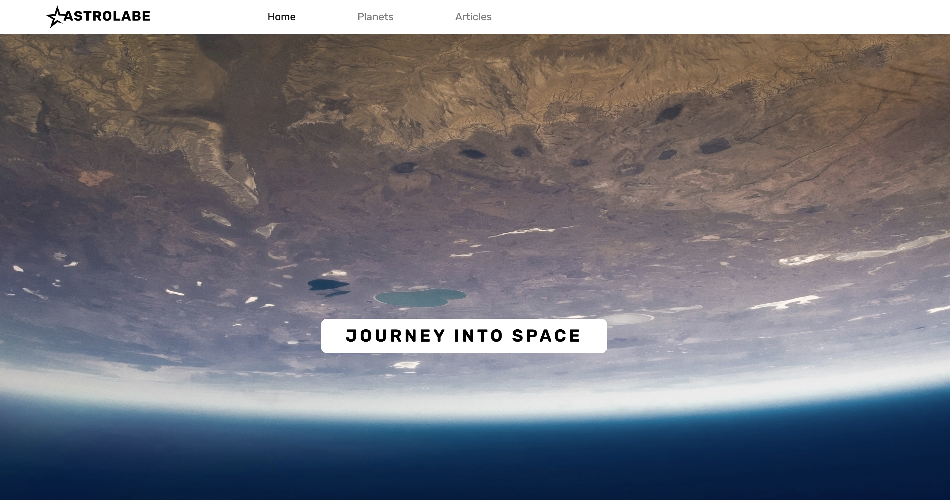
Description
Astrolabe will show the planets in our solar system and using API’s provide information on the latest in space and astronomy news. I wanted 4 different pages including a Home page. A Planets page with all the planets in our solar system and where you click on the photo and you will get the relevant information on each planet. An Articles page which will display the API’s, and a blog page which allows the user to engage with the content.

Slide 4
02
Challenges

Slide 5
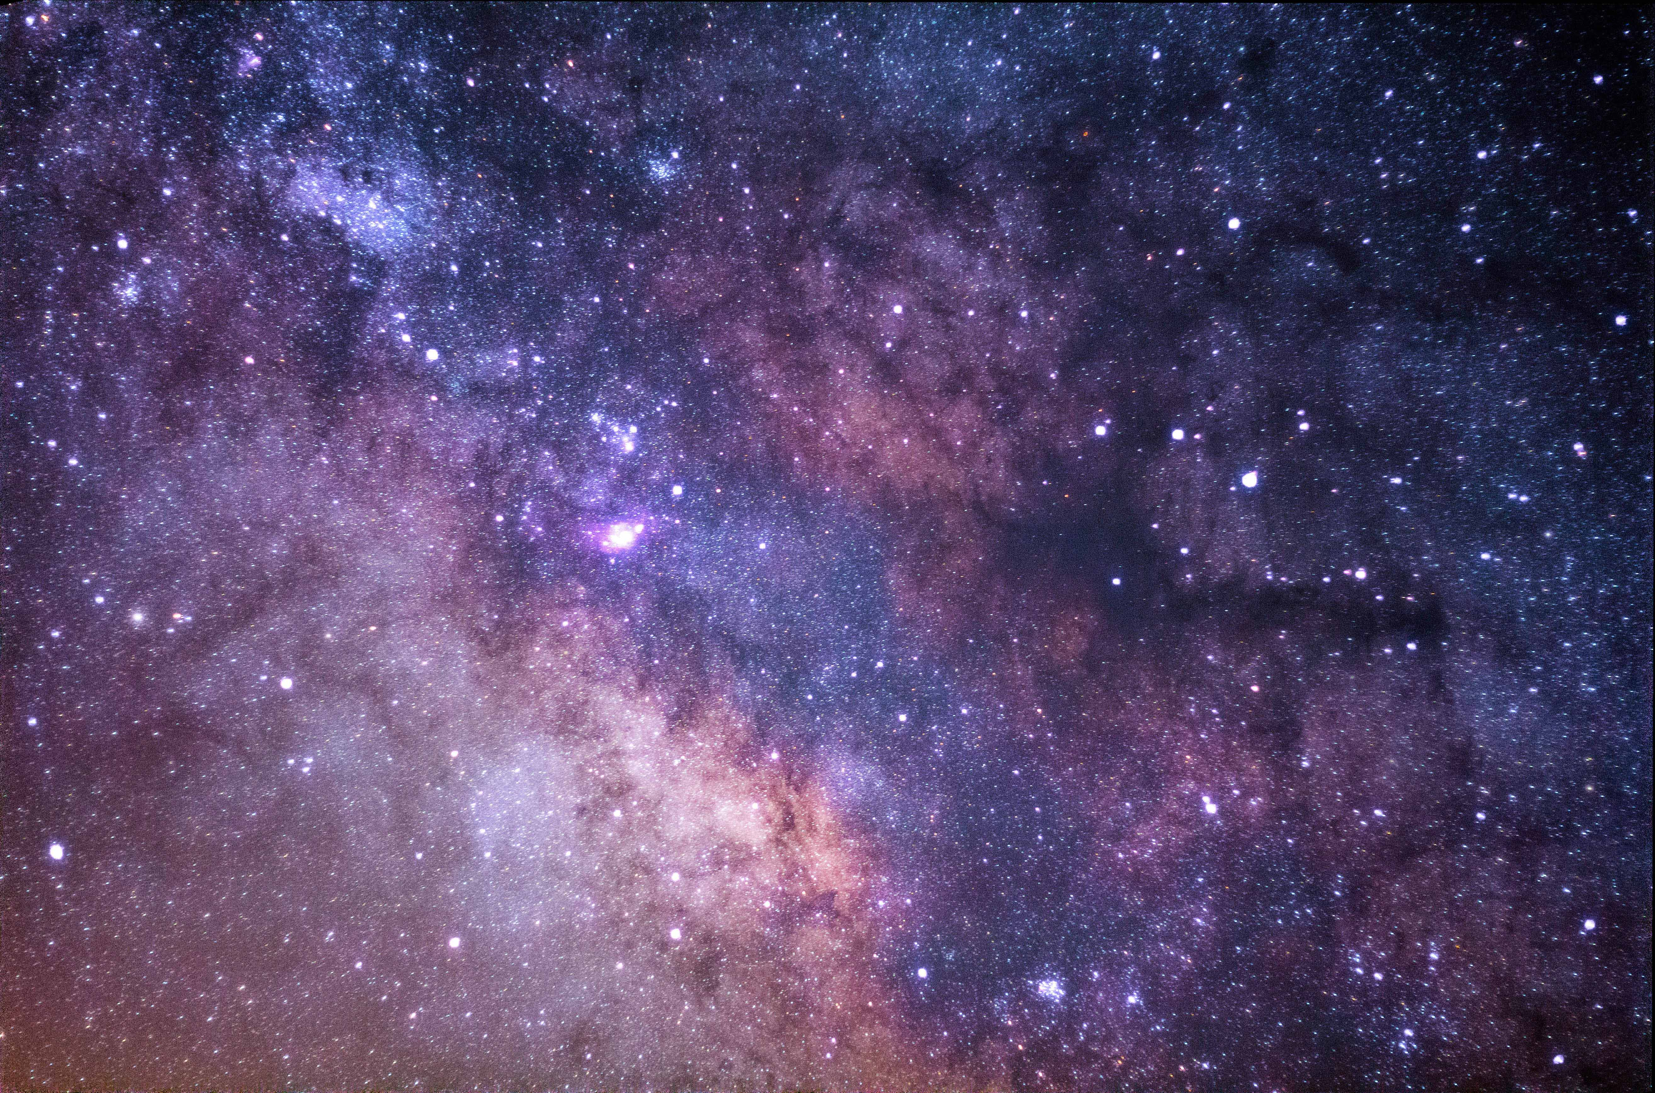

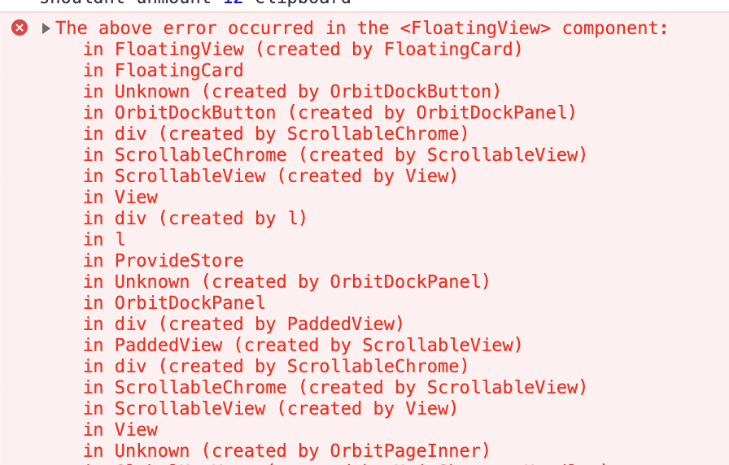
Challenges I Overcame
Error Message
Other
60%
40%
Setting up React /
Fetch / Props / Routes /
/ Getting API’s Working /
CSS

Slide 6
03
What Did I Learn

Slide 7
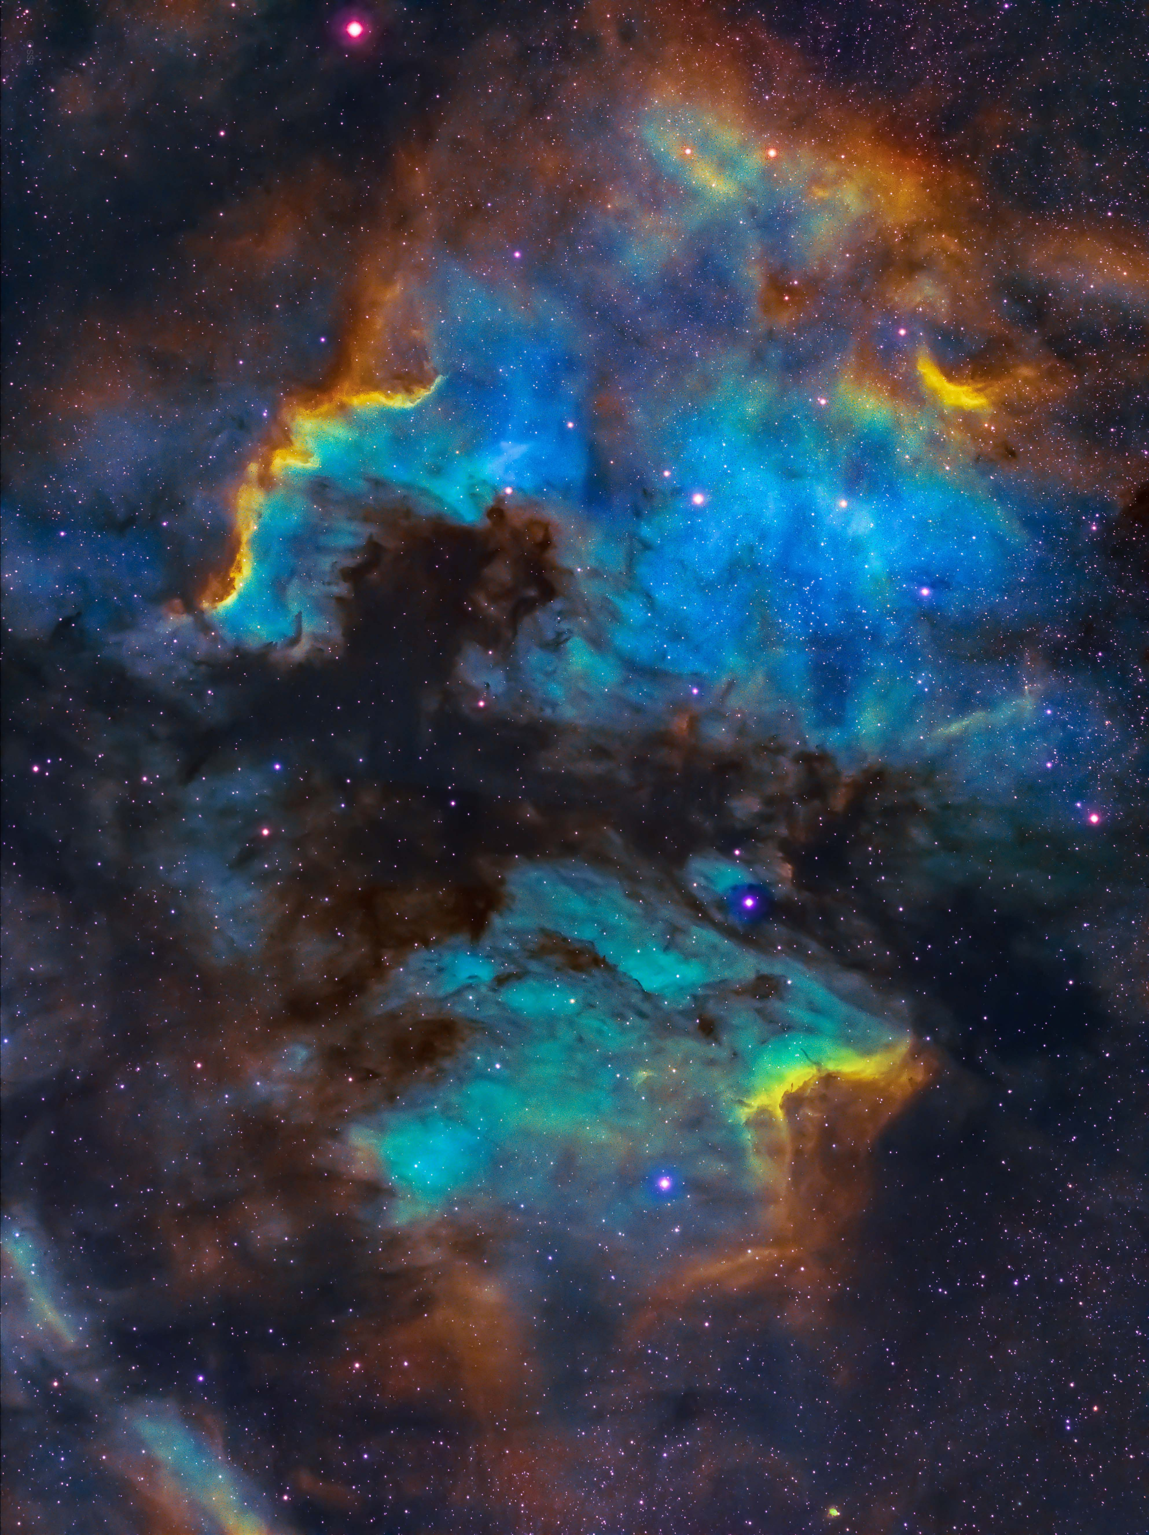
Findings
01
React can be fun!
04
Set a timer on ideas
05
Google will always be your friend when developing
03
Ask for help!
02
Be comfortable with the error message

Slide 8
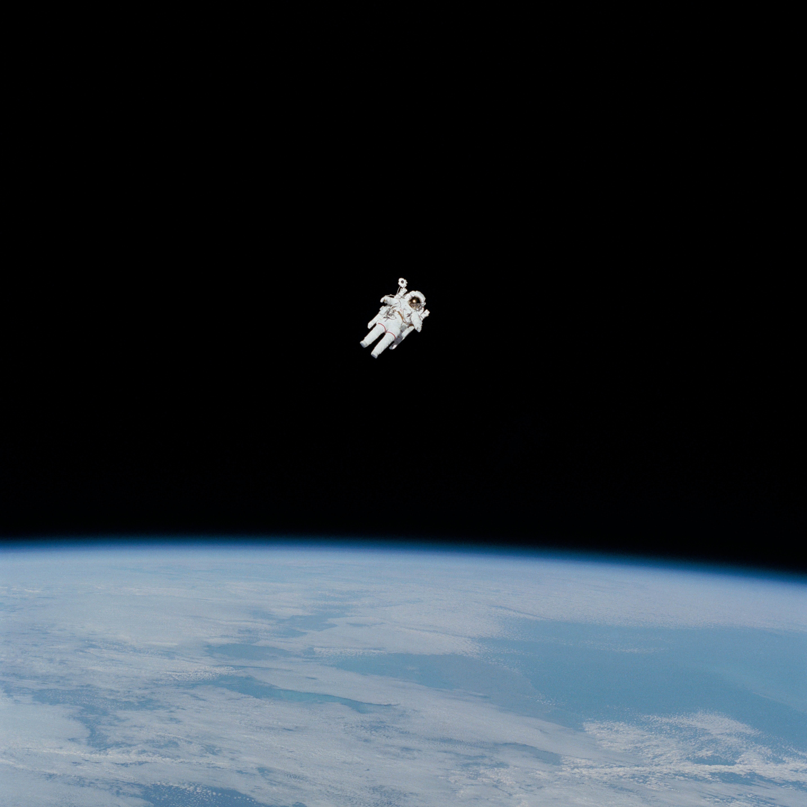
JOURNEY INTO SPACE

